Slide 1
Edge Computing
Lecture 03: Edge Systems: Architecture

Slide 2
Recap
Evolution of computing paradigm
Dist. vs Cent.
Cloud View vs Edge View
Virtualization
Virtual machine & containers
Applications
From design to deployment

Slide 3
Agenda
The IoT Challenge
Bandwidth, latency, throughput, pipeline
Example system architectures
Close-the-loop: sensing, compute, actuation

Slide 4
The IoT Challenge
IoT devices have been viewed as simple nodes that collect data from sensors and then transmit it to a central location for processing.
Cloud computing -> Edge computing (BLERP)
Bandwidth, latency, economics, reliability, privacy
But how much compute?

Slide 5
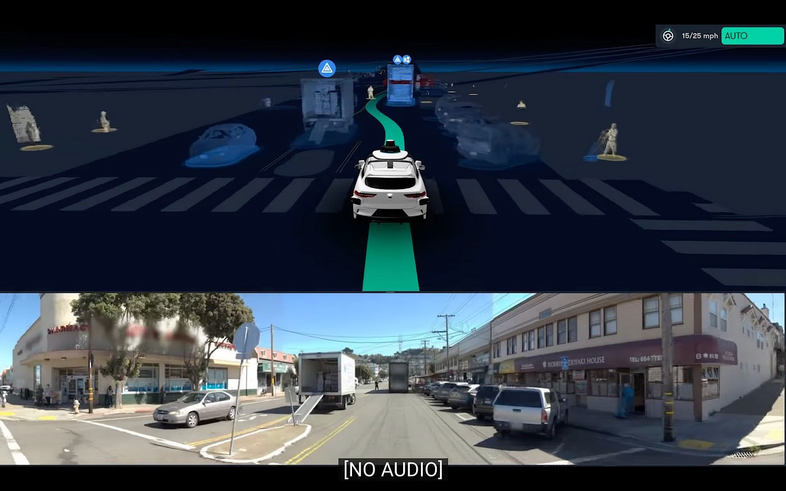
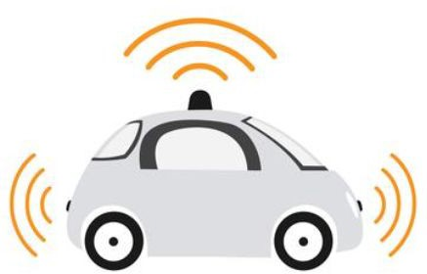
How much compute?
Perception
Localization
Prediction
Reasoning
Planning
Autonomous Vehicle

Slide 6
FPS! (Frame per Second)
Let’s say the car is driving on a freeway at 65 mph (105 km/h).
That means it’s going at 95 feet per second (~29 meters).
Average stopping time at that speed is 120 feet.
If the decision your car has to make is an immediate stop from the moment an object is detected, then the stopping distance will be:

Slide 7
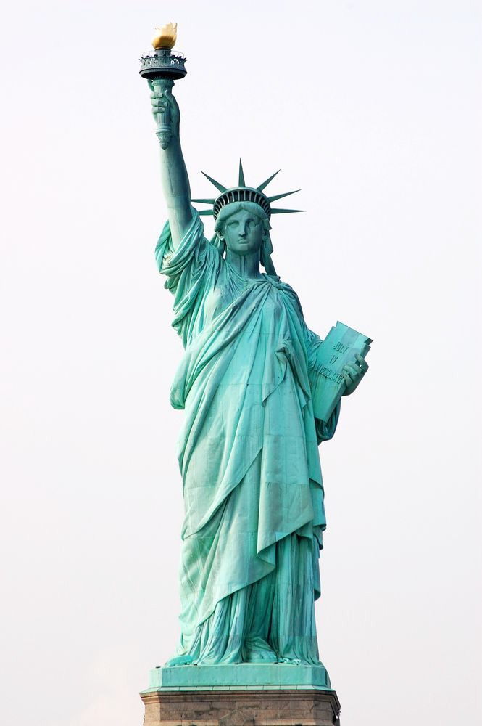
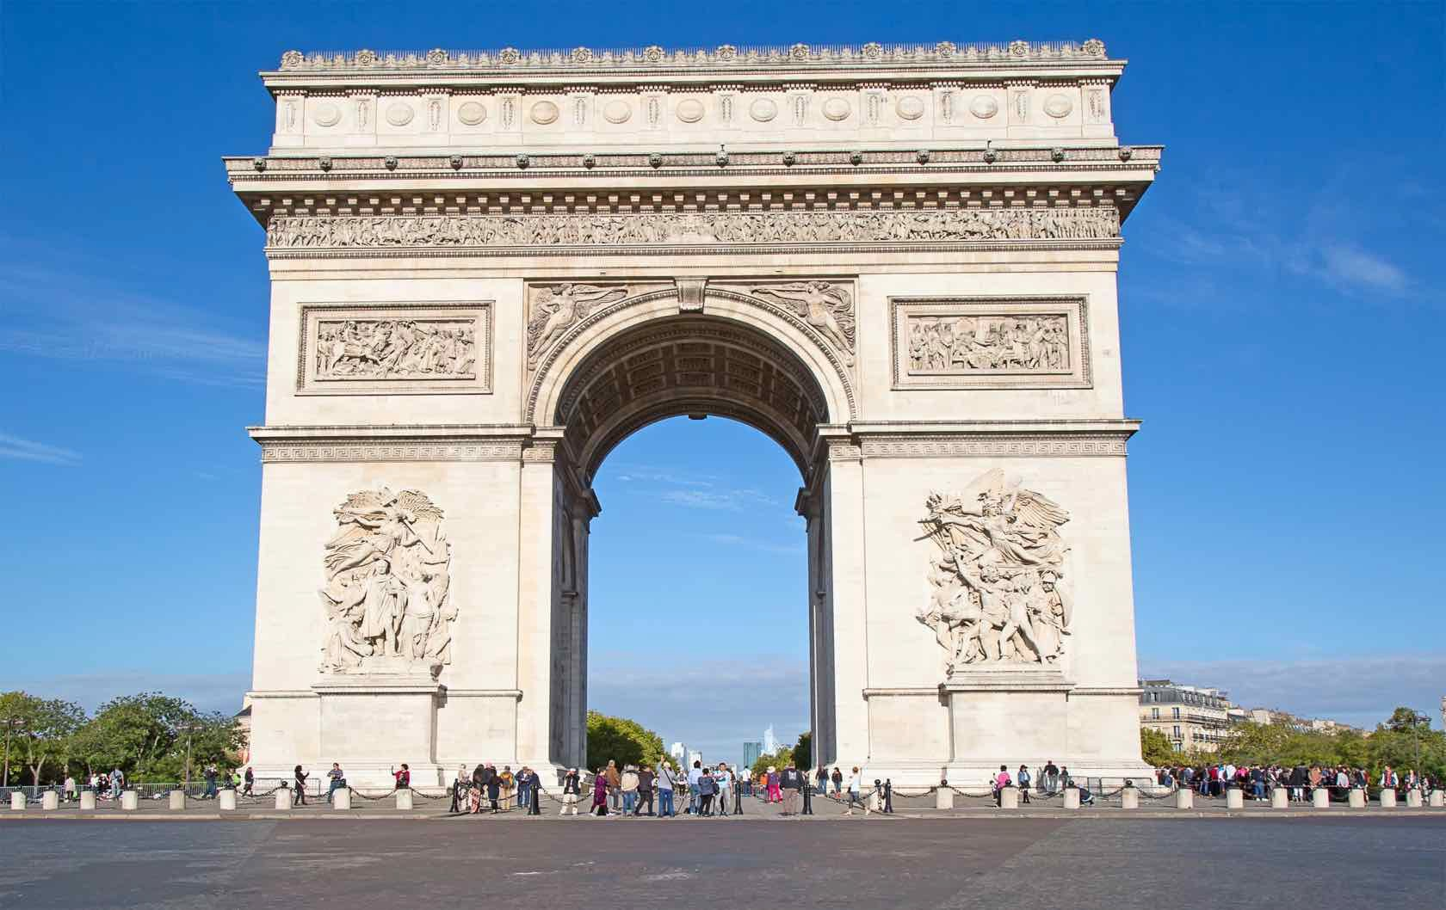
Frames per Second | Distance (feet / m) | Comparison
1 | 215 / 65 | Statue of liberty (w/o foundation)
5 | 139 / 42 | The Arc de Triomphe
15 | 126 / 38.4 | Football field + a refrigerator
30 | 123 / 37.4 | Football Field

Slide 8
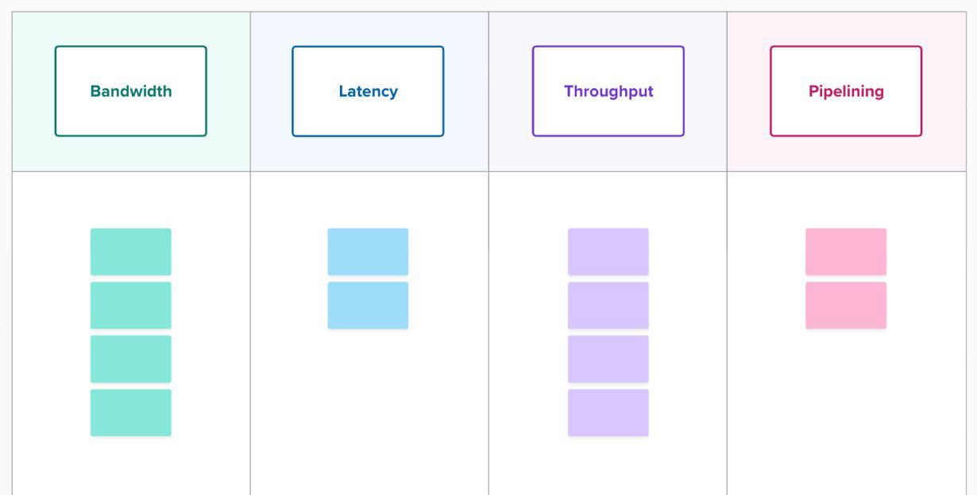
Flash activity
Quiz 00: What is Bandwidth, Latency, Throughput, Pipelining
Join Mural workspace: link
Open whiteboard: link

Slide 9
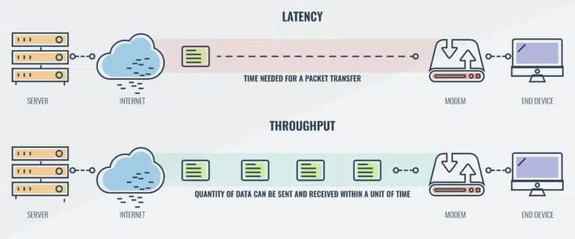
Latency vs Throughput
https://www.comparitech.com/net-admin/latency-vs-throughput/

Slide 10
Latency vs Throughput
Questions
Larger bandwidth == shorter latency?
https://www.comparitech.com/net-admin/latency-vs-throughput/

Slide 11
Latency vs Throughput
Questions
Larger bandwidth == shorter latency?
Larger bandwidth == larger throughput?
https://www.comparitech.com/net-admin/latency-vs-throughput/

Slide 12
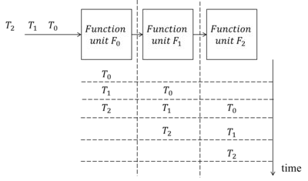
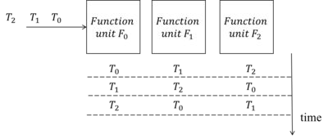
Pipeline
What is parallelizable? Why?
https://en.wikipedia.org/wiki/Pipelining_(DSP_implementation)

Slide 13
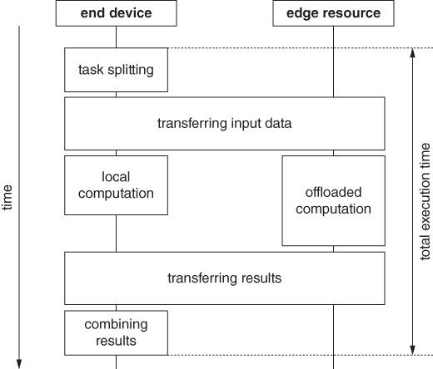
Execution Time

Slide 14
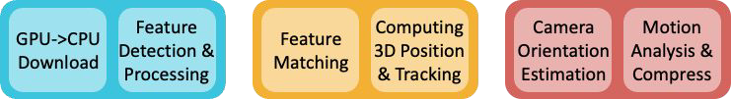
Example
Stage 1: Preprocessing | Stage 2: Localization | Stage 3: Postprocessing
18ms | 33ms | 28ms
Optimal latency?
Optimal FPS / throughput?

Slide 15
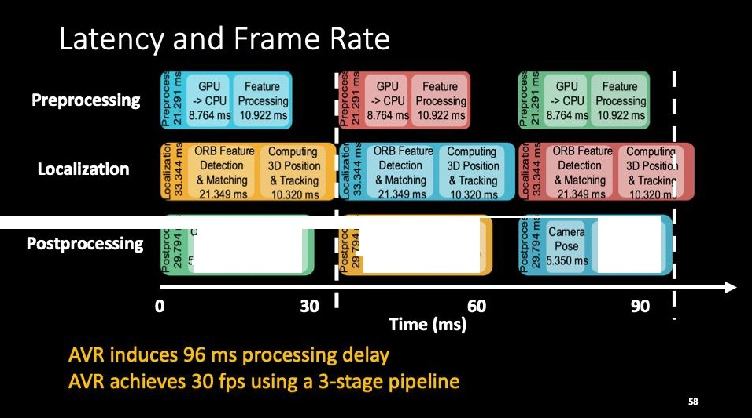
amera Pose
.350ms
Camera Pose
5.350ms
Motion Analysis & Compression
23.309 ms
Motion Anmysis & Compression
23.309 ms
Analysis& Compression 23.309ms

Slide 16
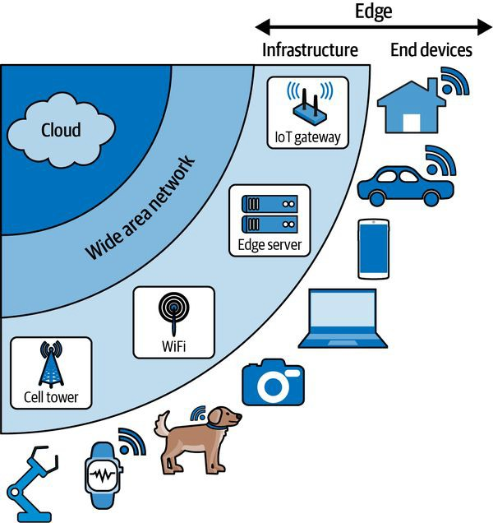
Edge Systems Architectures
Wildlife Monitoring
Voice Assistant
Self-driving Cars
Situnayake, D., & Plunkett, J. (2023). AI at the Edge. O'Reilly

Slide 17
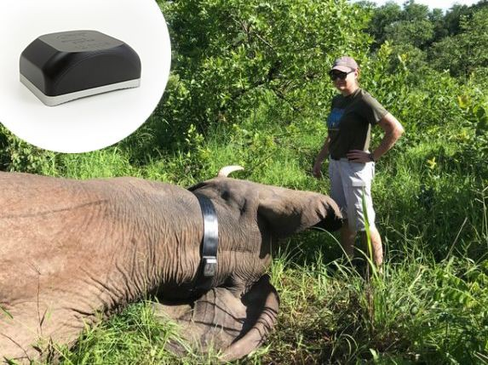
Edge Systems Architectures
Wildlife Monitoring
Situnayake, D., & Plunkett, J. (2023). AI at the Edge. O'Reilly

Slide 18
Edge Systems Architectures
Wildlife Monitoring
Periodic GPS beacons -> cloud
Device
Edge/Cloud
Device Compute | Bandwidth Available | Latency Requirement | Edge/Cloud Compute

Slide 19
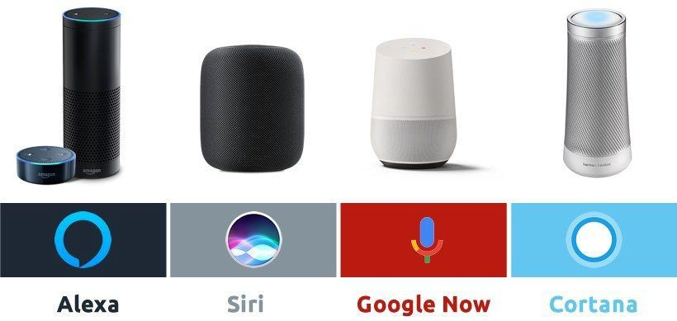
Edge Systems Architectures
Voice Assistant
“Hey Google” “Hey Siri” “Alexa” “Cortana”
https://www.geeksfl.com/blog/best-voice-assistant/
Situnayake, D., & Plunkett, J. (2023). AI at the Edge. O'Reilly

Slide 20


Edge Systems Architectures
Voice Assistant
Device
Edge/Cloud
Wake-up word -> device
Large language model -> cloud
Device Compute | Bandwidth Available | Latency Requirement | Edge/Cloud Compute
https://www.geeksfl.com/blog/best-voice-assistant/

Slide 21
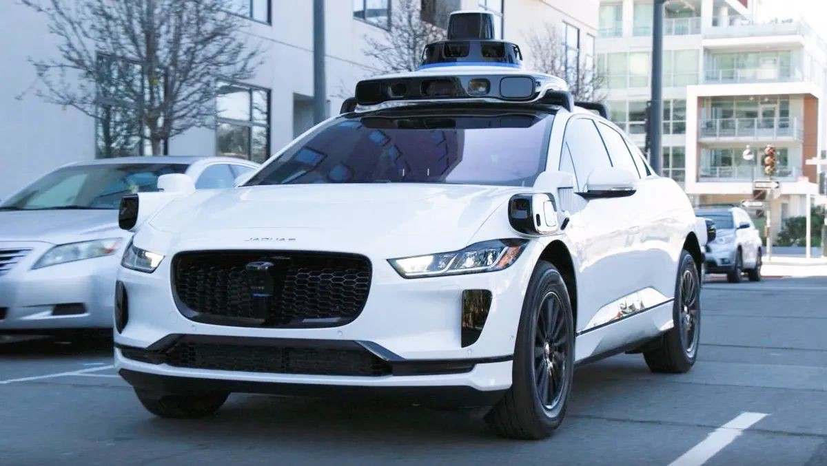
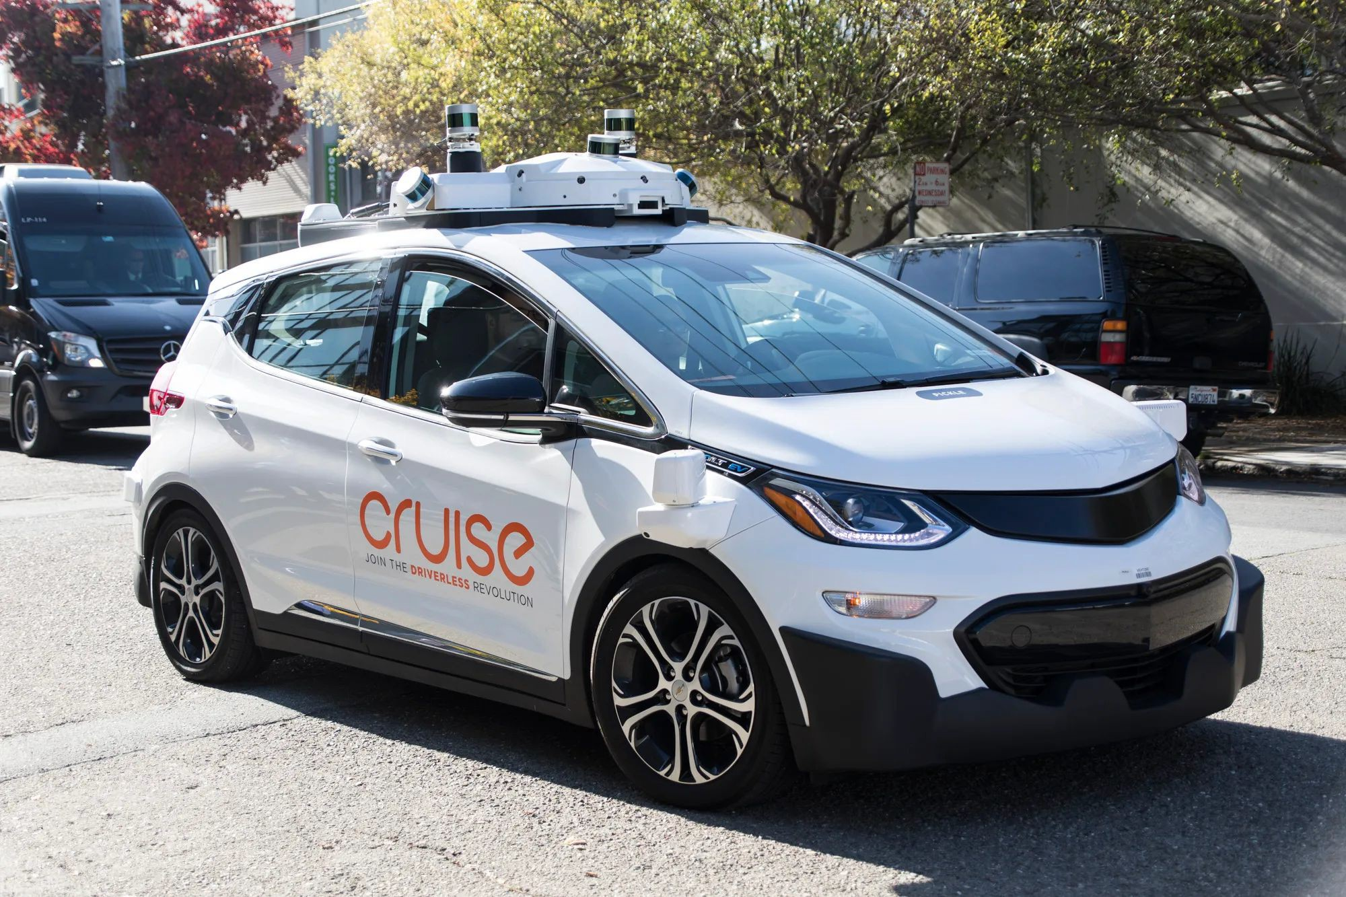
Edge Systems Architectures
Self-driving cars
Situnayake, D., & Plunkett, J. (2023). AI at the Edge. O'Reilly

Slide 22
Edge Systems Architectures
Self-driving cars
Sensor data -> onboard compute
Device
Edge/Cloud
Device Compute | Bandwidth Available | Latency Requirement | Edge/Cloud Compute

Slide 23
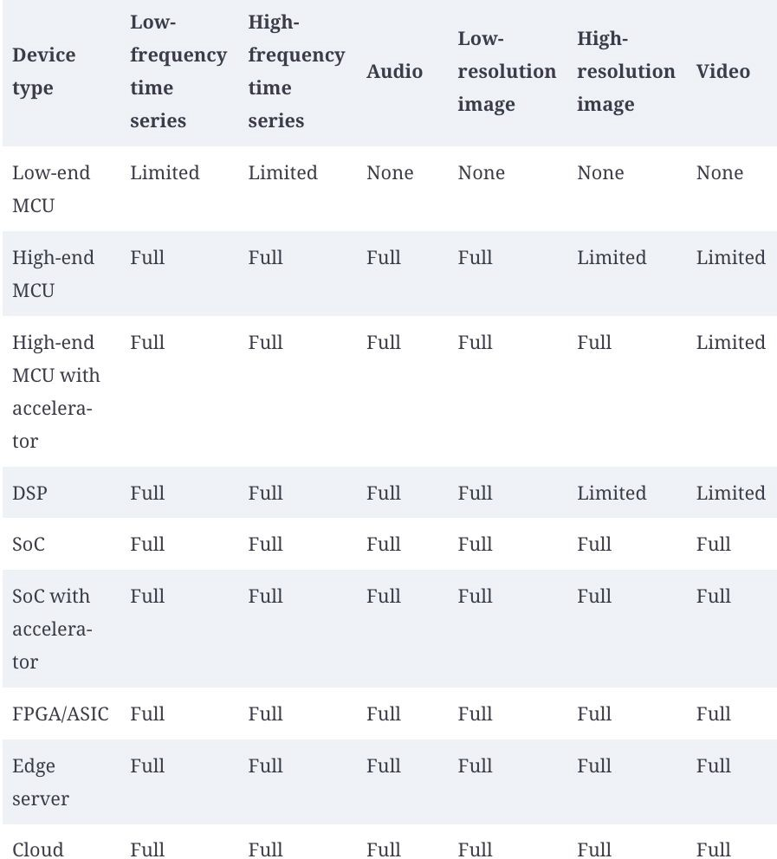
Offloading
Higher workload
Workload vs compute
More Compute

Slide 24
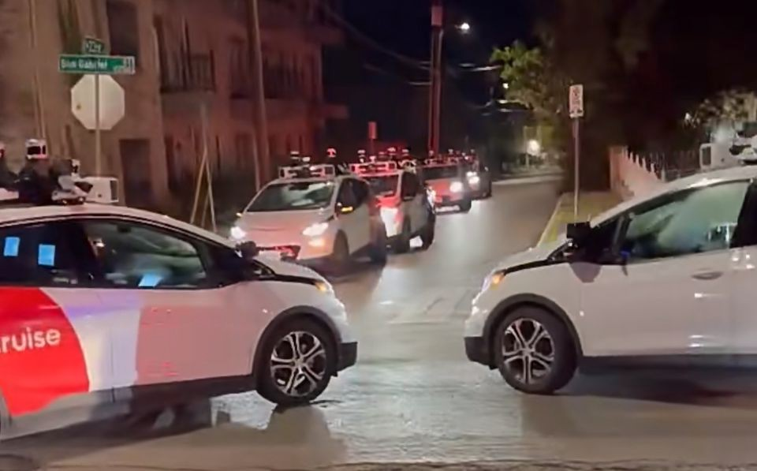
Close-the-loop: sensing, compute, actuation
Moving Data to Compute vs Moving Compute to Data

Slide 25
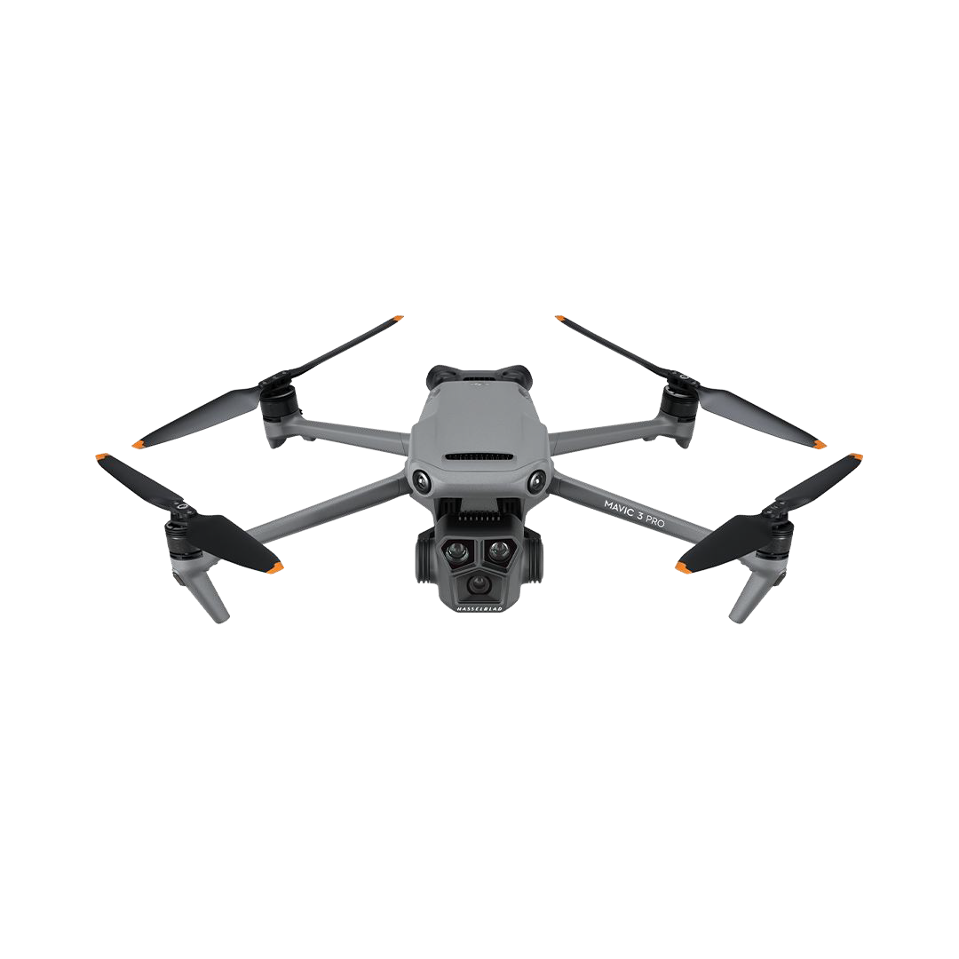
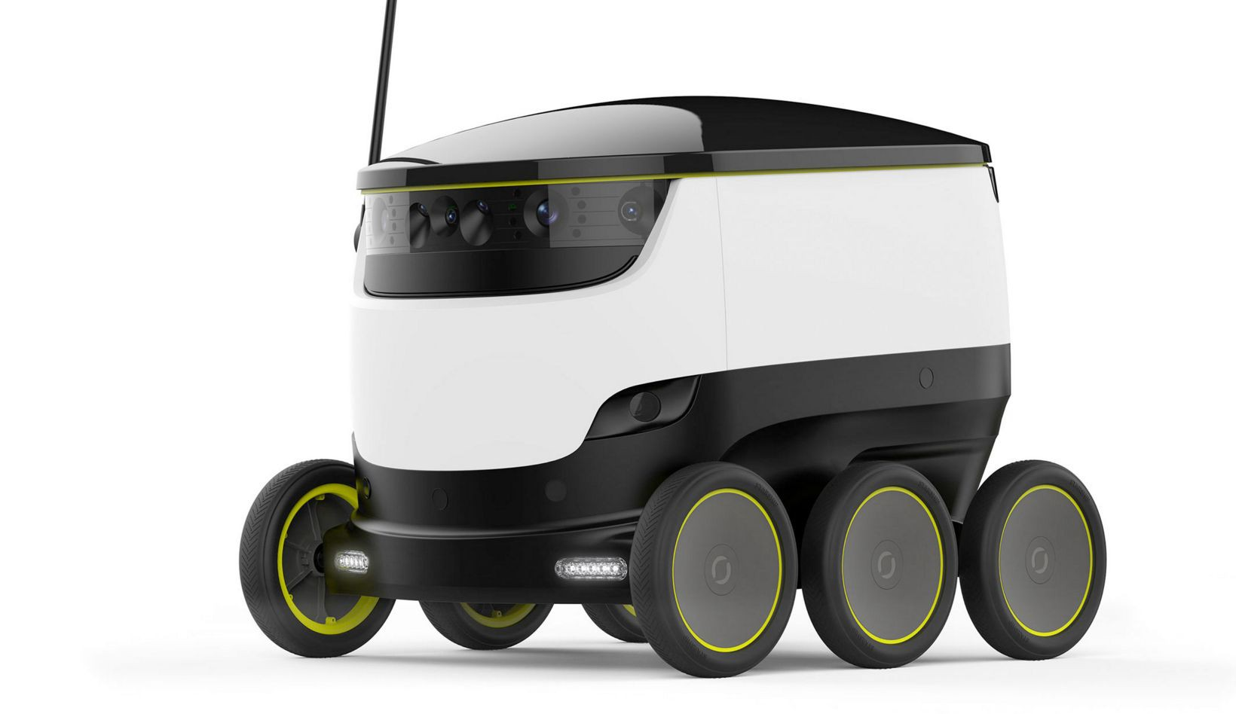


Remote Operation for Self-driving Cars
Perception
Localization
Prediction
Reasoning
Planning
Is it foggy?
Where is that traffic
Are peds crossing?
Why is that police
Shall I pass?
light in the map?
officer waving at me?
Data Visualization
Request Dispatch
Remote Monitoring
Autonomous Vehicles
Resolution
Data Visualization
Remote Operator

Slide 26
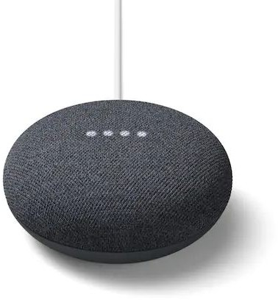
Smart Home Actuation
“Hey Google, turn off lights”
“Hey Siri, close curtains”

Slide 27
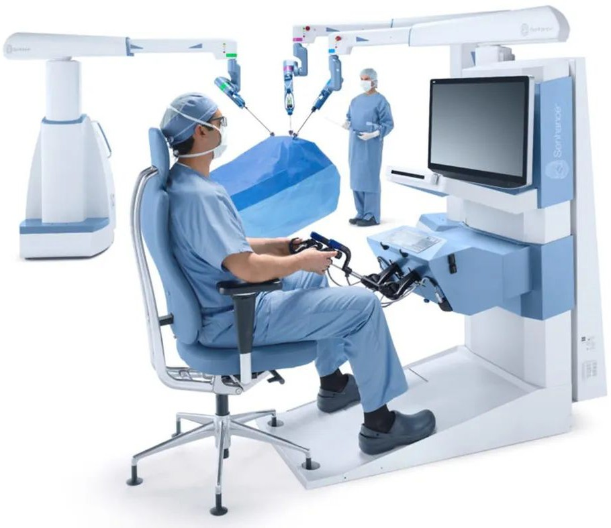
Telesurgery
Robot arm actuation
https://www.zdnet.com/article/surgery-digitized-telesurgery-becoming-a-reality/

Slide 28
Summary
The IoT Challenge
Bandwidth, latency, throughput, pipeline
Example system architectures
Close-the-loop: sensing, compute, actuation

Slide 29
Next Lectures
Lab 1: profile performance, data for design optimization
Optimization techniques
Edge ML basics

